Slide 1
Fluid Simulation
Lecturer: Bashar Beshoti

Slide 2
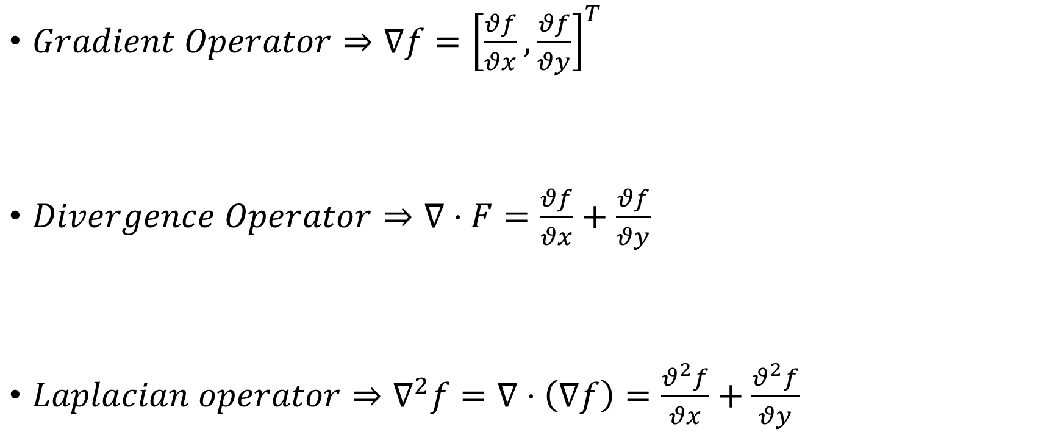
Quick Math Reminder
$Gradient Operator⇒∇f={\left[\frac{θf}{θx},\frac{θf}{θy}\right]}^{T}$
$Divergence Operator⇒∇⋅F=\frac{θf}{θx}+\frac{θf}{θy}$
$Laplacian operator⇒∇^{2}f=∇⋅\left(∇f\right)=\frac{θ^{2}f}{θx}+\frac{θ^{2}f}{θy}$
Notes:
Quick Mathematical Reminder of operations we are going to use; 1. Gradient operator 2. Divergence operator
3. Laplacian operator

Slide 3
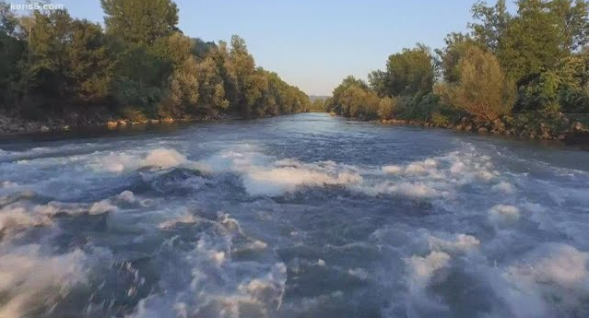
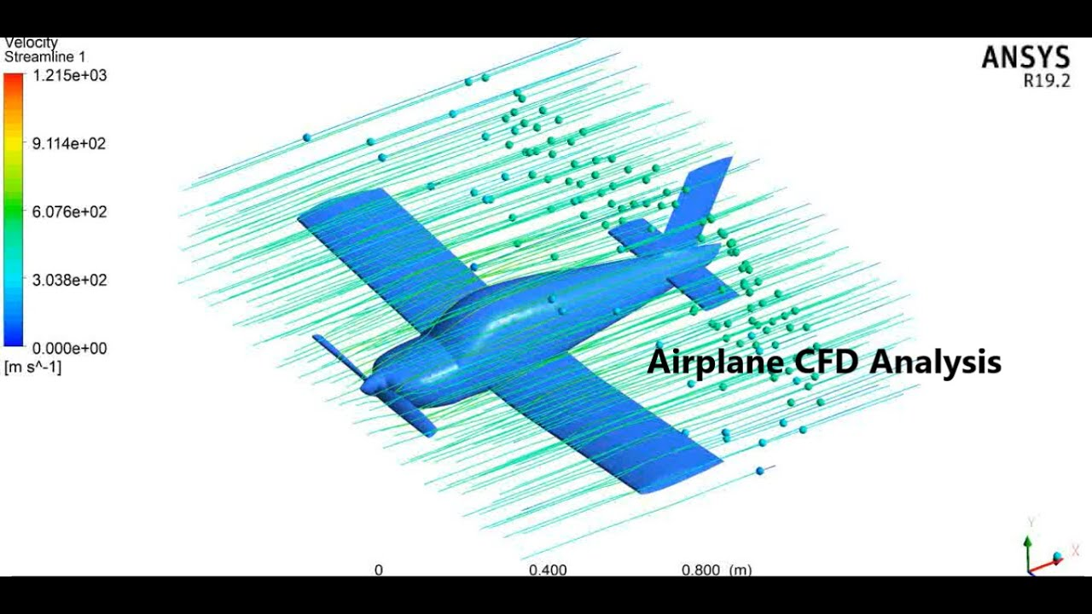
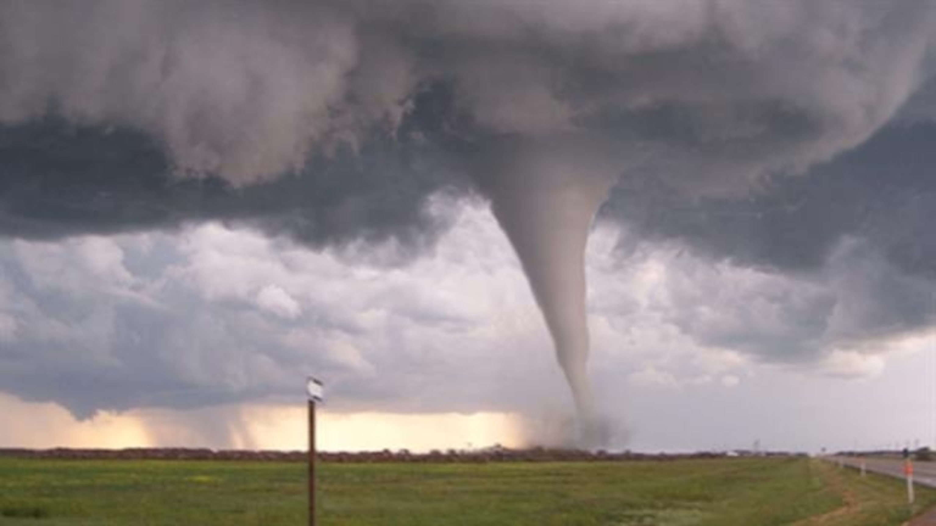
Fluid Simulation
Notes:
There are various uses of Fluid Simulation in daily life such as predicting water current, simulating air pressure on airplane pre-flight and forecast weather

Slide 4
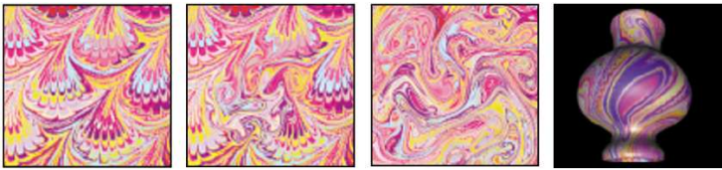
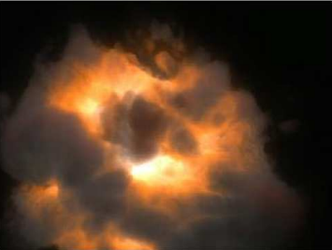
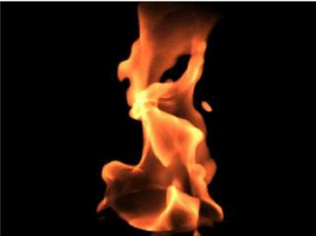
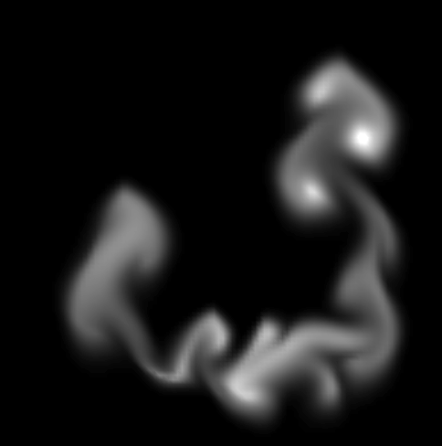

Rendering
Figure 4: shows fluid rendered to texture and mapped onto vase. [Stam 2001]
Figure 3: is created with MAYA Fluid Effects and shows volume rendered nebula and fire. [Stam 2001]
Figure 2 : smoke simulation based on fluid simulation.
Figure 1 : Fluid dynamic motion. [West 2008 & Stam 1999]
Notes:
Examples of Fluid simulation usages:
1. Fluid Dynamic Simulation
2. Gas and smoke
3. Fire & Nebula,
4. Dye and Texture

Slide 5
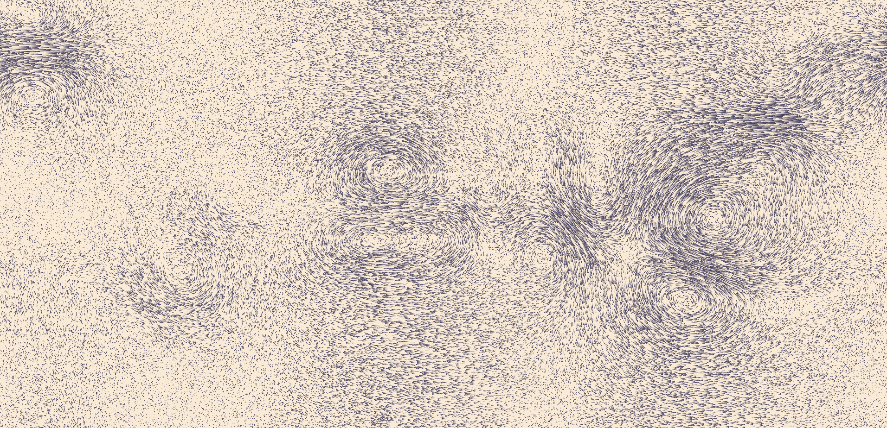
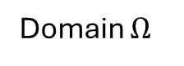
Input
60 FPS
Domain $Ω$
Notes:
Let's first discuss of what we have and what is the domain of Fluid Simulation.
Let’s say you brought a cup of water and start steering it around or pouring out from the water-cooling machine.
You be noticing two variables for the movement; velocity and density of particle.

Slide 6
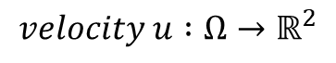
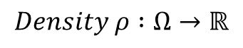
What is Fluid Simulation?
60 FPS
$$Density ρ :Ω→ℝ$$
$$velocity u :Ω→ℝ^{2}$$
Notes:
We have two different variables that define a fluid motion on 2d plane; Density and Velocity.

Slide 7
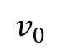
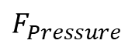

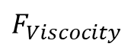
Single Particle Movement
$$F_{Pressure}$$
$$v_{0}$$
$$F_{Viscocity}$$
$$F_{External}$$
Notes:
To understand the fluid movement across, let’s dive in a single particle movement.
Pressure, Viscosity and External are mainly used for simulation.
1. External can be depicted as particles gravity, earth gravity or force labels.
2. Viscosity is resulted by static or Kinetic friction presented as resistance of fluid motion.
3. Pressure is resulted by the tension between particles

Slide 8
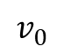
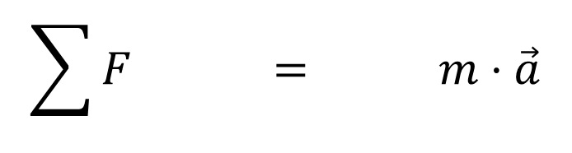
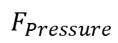

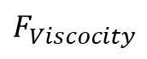
Single Particle Movement
2nd Newton Law
$$\sum{F} = m⋅\vec{a}$$
$$F_{Pressure}$$
$$v_{0}$$
$$F_{Viscocity}$$
$$F_{External}$$
Notes:
Based on 2nd Newton Law, sum of the forces equal to multiplication of mass and acceleration vector.

Slide 9
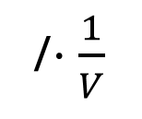

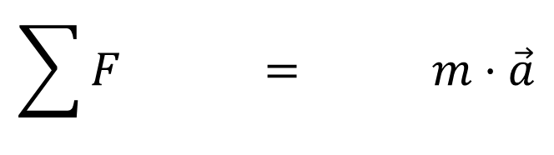
Single Particle Movement
2nd Newton Law
$$\sum{F} = m⋅\vec{a}$$
$$F_{Pressure}$$
$$\sum{F}=m⋅\vec{a}$$
/$⋅\frac{1}{V}$
$$v_{0}$$
$$F_{Viscocity}$$
$$F_{External}$$
Notes:
Divided By Volume of each particle, we get:

Slide 10

Single Particle Movement
2nd Newton Law
$$\sum{F} = m⋅\vec{a}$$
$$F_{Pressure}$$
$$\sum{F}=m⋅\vec{a}$$
/$⋅\frac{1}{V}$
$$v_{0}$$
$$\frac{\sum{F}}{V}=\frac{m}{V}⋅\vec{a}= ρ\frac{θv}{θt}$$
$$F_{Viscocity}$$
$$F_{External}$$

Slide 11
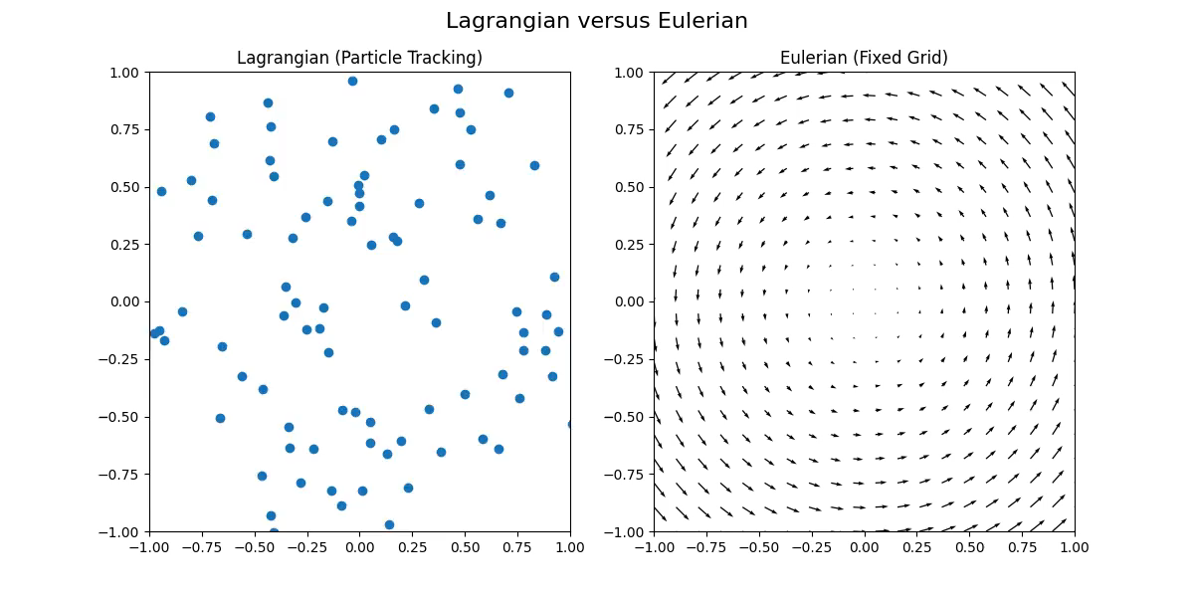
Lagrangian and Eulerian Viewpoints
Notes:
Two different methods are used to create a fluid simulation; Lagrangian and Eulerian
Lagrangian: describes motion as points travel around space over time (Particles View).
Eulerian: describes motion as the change of velocity field in a stationary domain (Grid View)

Slide 12
Millennium Prize Problems
Birch and Swinnerton-Dyer conjecture
Hodge conjecture
Navier–Stokes existence and smoothness
P versus NP
Riemann hypothesis
Yang–Mills existence and mass gap
Poincare Conjecture (solved at 2010)
Notes:
You guys heard about P versus NP in Model Of Computation course.
Fluid simulation is based on Navier-strokes equations, and there is a prize of 1 million dollar to find a solution of this problem.
People tried to solve few approaches hoping to get a clear answer and solution of this problem, for example: 1. Weak Navier Strokes 2. Differential Geometry to show that the fluid travel in certain paths 3. Probabilistic analysis on fluid motion that predicts how the fluid travel yet all failed to find a solution

Slide 13
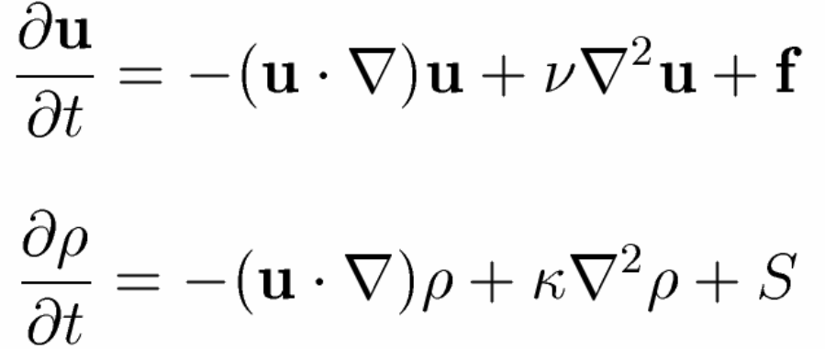
The Navier-Stokes Equations
Advection
Diffuse
External Force
Notes:
The equation for a density moving through the velocity field:
The density should follow the velocity field referred as Advection.
The density may diffuse at a certain rate referred as Diffuse.
The density increases due to sources referred as External Force.

Slide 14
The Navier-Stokes Equations
Self-advection
viscous diffusion
External Force
Notes:
The equation for a velocity moving along it’s velocity field: Moving a velocity field over itself referred as Self-advection
a simple Kinetic friction force that applies to the velocity field called viscous diffusion
The velocity increases due to sources referred as External Force.

Slide 15
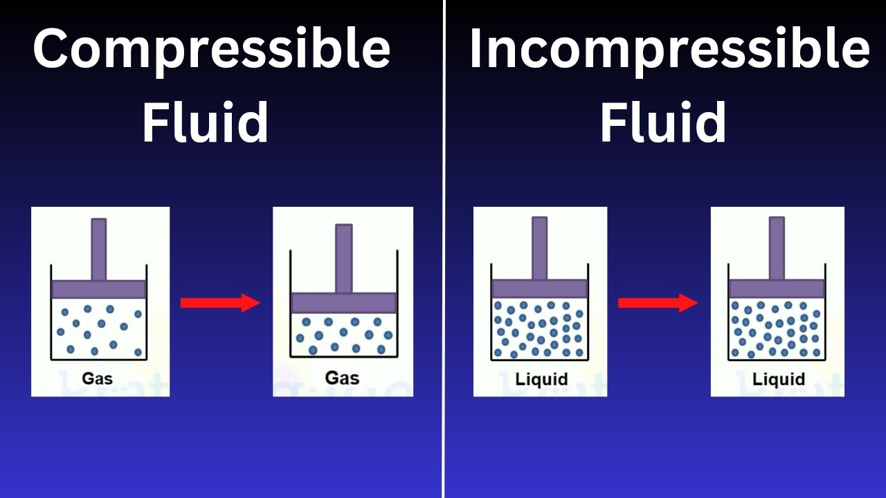
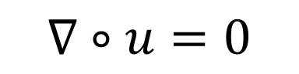
The Navier-Stokes Equations Condition
$$∇∘u=0$$
THE FLUID IS IMCOMPRESSIBILE AND MASS CONSERVING
Divergence and curl: The language of Maxwell's equations, fluid flow, and more - YouTube
Notes:
The Navier-Stokes Equations Condition, NO DIVEERGENCE ALLOWED! Convergence must be nullified sustaining CURLS only!.

Slide 16
Experiment Assumptions
NEWTONIAN
ISOTHERMAL
CONTINUOUS
IMCOMPRESSIBLE
Notes:
Newtonian fluid is one whose viscosity is not affected by shear rate.
Isothermal fluid doesn’t undergo temperature to any processes occurring.
Continuous fluid, I think you all get what I mean, it’s a fluid Afterall
Incompressible fluid, a fluid that can not be compressed not any under circumstances.

Slide 17
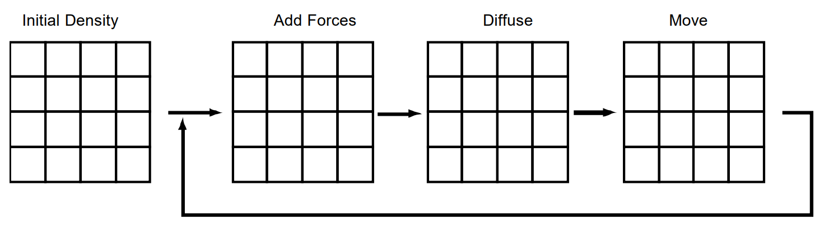
Fluid Density Field
Advection
Notes:
As I previously mentioned, Navier strokes consist of 3 different steps that applied to density and velocity.
Adding Forces – External force
Diffuse – Fluid scatter force
Advection – Fluid Pressure

Slide 18
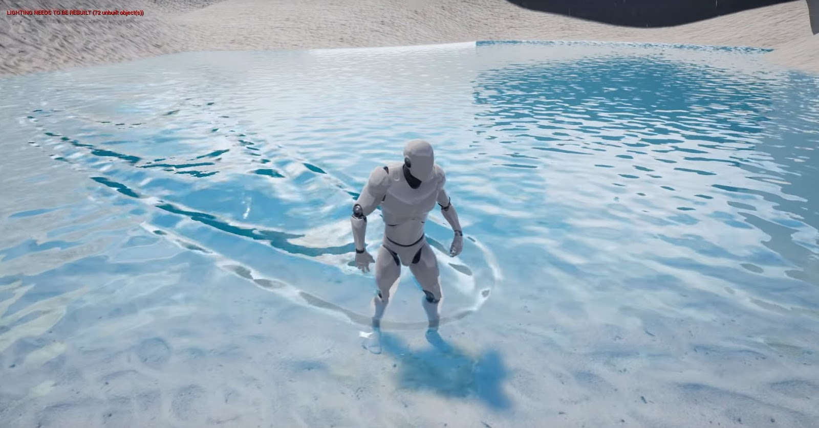
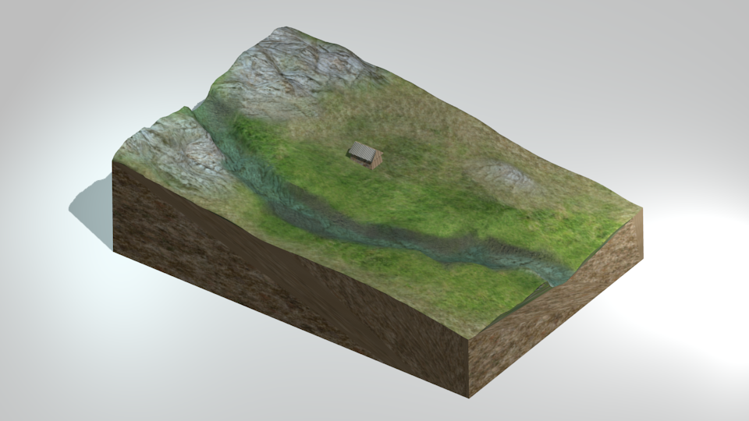
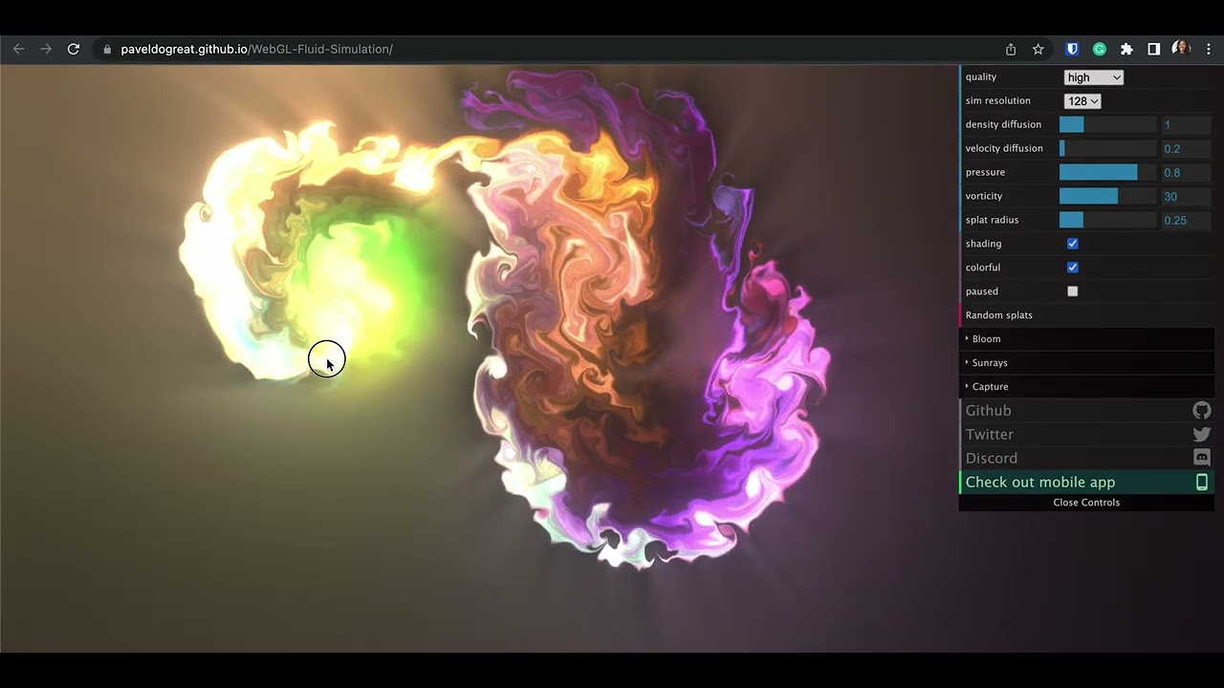
Step I : Adding Forces
Common forces addition methods:
Game Object (Grid’ s settings)
User Interaction
Collision Between Objects
Temperature
Environment Physics
Notes:
Different common methods to add forces to the fluid

Slide 19
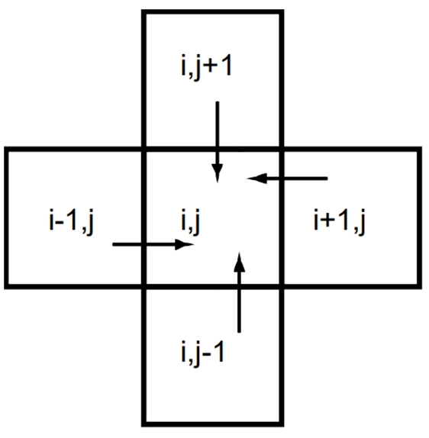
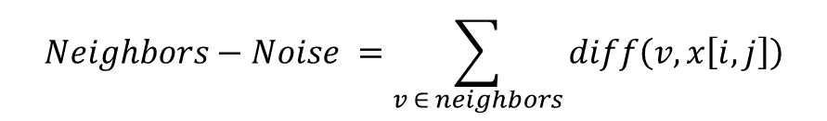
Step ii : Diffuse
Poor Implementation - SOD:
$$Neighbors−Noise =\sum_{v ∈ neighbors}{diff\left(v,x\left[i,j\right]\right)}$$
$$=\overset{Neighbors}{\overbrace{x\left[i−1,j\right]+x\left[i+1,j\right]+x\left[i,j−1\right]+x\left[i,j+1\right]}}−\overset{Grid cell}{\overbrace{4⋅x[i,j]}}$$
Notes:
First Attempt was written in the article is Sum of differences between cell and it’s 4 neighbors.

Slide 20
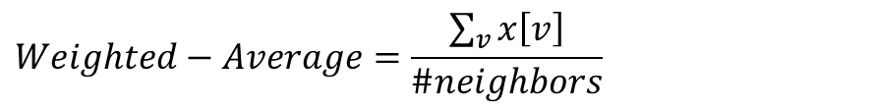
Step ii : Diffuse
Poor Implementation – Weight Average:
$$Weighted−Average=\frac{\sum_{v}{x\left[v\right]}}{\#neighbors}$$
$$=\frac{x\left[i−1,j\right]+x\left[i+1,j\right]+x\left[i,j−1\right]+x\left[i,j+1\right]}{4}$$
Notes:
Second Attempt was written in the article is Weight Average between cell’s neighbors.

Slide 21
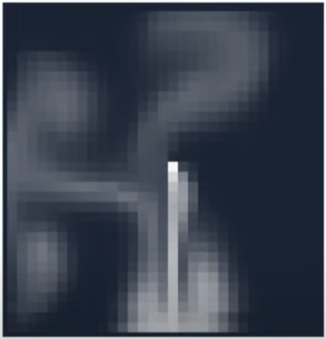
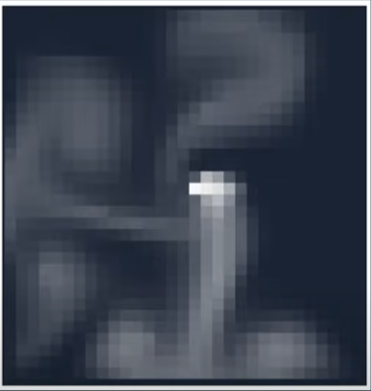
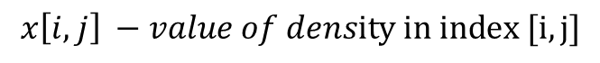
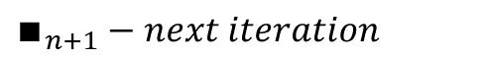
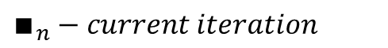
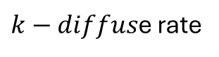
Smooth Diffuse (Attempt 3)
Stam [2003]
$$x\left[i,j\right] −value of density in index [i,j]$$
$$s\left[i,j\right] −value of density in index \left[i,j\right] after computing weight−average$$
$k−diffus$e rate
$∎_{n}−current iteration$
$∎_{n+1}−next iteration$
Current frame
Next frame
Notes:
instead of just using the current values to calculate the next values.
we try to find the next values which when rewinded back in time results in the current values

Slide 22
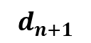
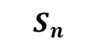
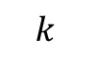

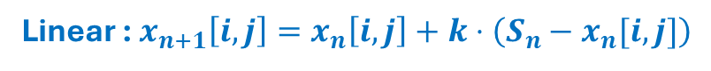
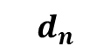
Jos Stam Trick
Rewind in Time
Linear : $x_{n+1}\left[i,j\right]=x_{n}\left[i,j\right]+k⋅\left(S_{n}−x_{n}[i,j]\right)$
Hyperbolic : $x_{n}\left[i,j\right]=x_{n+1}\left[i,j\right]−k⋅\left(S_{n+1}−x_{n+1}[i,j]\right)$
$$x_{n+1}\left[i,j\right]=\frac{x_{n}\left[i,j\right]+kS_{n+1}}{1+k}$$
$$d_{n+1}$$
$$S_{n}$$
$$d_{n}$$
$$k$$
Notes:
Using this trick, it will not overshoot the target value but converge to it no matter how big k is. Yet, it presents another problem, We would need to know the next iteration surrounding which we obviously don’t know yet.

Slide 23
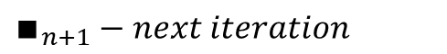
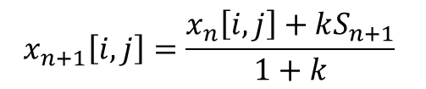
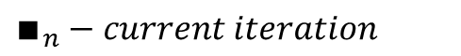
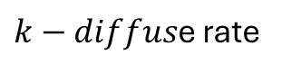
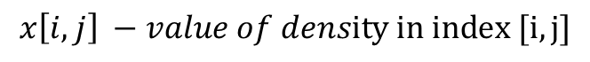
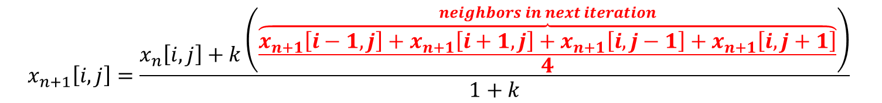
Sparse Linear system
$$x\left[i,j\right] −value of density in index [i,j]$$
$$x_{n+1}\left[i,j\right]=\frac{x_{n}\left[i,j\right]+kS_{n+1}}{1+k}$$
$$s\left[i,j\right] −value of density in index \left[i,j\right] after computing weight−average$$
$k−diffus$e rate
$∎_{n}−current iteration$
$∎_{n+1}−next iteration$
$$x_{n+1}\left[i,j\right]=\frac{x_{n}\left[i,j\right]+k\left(\frac{\overset{neighbors in next iteration}{\overbrace{x_{n+1}\left[i−1,j\right]+x_{n+1}\left[i+1,j\right]+x_{n+1}\left[i,j−1\right]+x_{n+1}\left[i,j+1\right]}}}{4}\right)}{1+k}$$
Notes:
Linear Equation System (SPARSE MATRIX) - Let’ s Expand the expression once again by compensate the value of $s_{n}$
Yet, we want the computer to be able to solve these equation no matter what the values are. So, we used Iterative Gauss Seidel Relaxation that can approximate what the solutions are.
We notice that coefficients are added up and then multiplied by k divided by 4 making it smaller than the dominator 1 + k

Slide 24
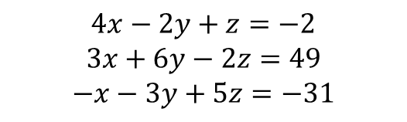


Gauss-Seidel relaxation
Example:
Given the following equation system :
$$x=\frac{−2+2y−z}{4}$$
$$y=\frac{49−3x+2z}{6}$$
$$z=\frac{−31+x+3y}{5}$$
$$4x−2y+z=−2$$
$$3x+6y−2z=49$$
$$−x−3y+5z=−31$$
Iteration | 0 | 1 | 2 | 3 | 4
x | 0 | -0.5 | 4.021 | 2.858 | 3.038
y | 0 | 8.417 | 5.740 | 6.087 | 5.989
z | 0 | -1.25 | -1.952 | -1.976 | -1.999
True Solution:
$$x=3 \\ y=6 \\ z=−2$$
Converge
Notes:
Example of System of equations
Each equation solved for correspond variable
Iterative solver
Conditions for use: 1. The Matrix must be strictly diagonally dominant which mean the coefficients that lie on the diagonal must have a magnitude that's larger than the sum of the magnitudes of all the other coefficients in that row.

Slide 25


Step ii : Diffuse
$$diffuse−rate=0.1$$
Notes:
Check the next for Bug ☺

Slide 26


Step ii : Diffuse
$$diffuse−rate=0.3$$
Notes:
This is a clear disadvantage of SOD Diffuse over Jos Stam diffuse where a $k$ is high enough to overshoot it’s expected/promised value
SOD lacks stability issues and inaccuracy calculations, Convergence and Physical Realism for fluid behavior.

Slide 27

Advection & Backtrace Advection
Back In Time[2003]
Notes:
Using the same concept of rewind back in time, we use the standard formula of ${\left[i,j\right]}_{n+1}={\left[i,j\right]}_{n}+v_{n}⋅dt.$
Forward advection calculation is moving a quantity from point P to points A,B,C and D while in reverse advection instead of moving the point forward in space, we invert the velocity and find the source point in the opposite direction, essentially back in time.

Slide 28


Advection
Notes:
Instead of using forward approach we will use backtrace where we calculate each index where his next value is coming from.
Jos Stams main advantages lie in its stability, accuracy, ability to maintain sharp interfaces, conservation properties, and effectiveness in handling complex flows.

Slide 29

Bilinear Interpolation
$$d\left[i,j\right]=\frac{t_{0}⋅s_{0}}{S_{total}}⋅d\left[i_{o},j_{0}\right]+\frac{t_{1}}{S_{total}}⋅d\left[i_{o},j_{1}\right]+\frac{t_{0}⋅s_{1}}{S_{total}}⋅d\left[i_{1},j_{0}\right]+\frac{t_{1}}{S_{total}}⋅d\left[i_{1} , j_{1}\right]$$
Notes:
After computing the new $p′$ we can easily compute the values that to be moved in this 4 cells that one of them would be the actually $p^{′}$ (timestep is really small)

Slide 30


Fluid Border Collision
$$x\left(0 ,0 \right)= 0.5⋅\left(x\left(1,0 \right)+x\left(0 ,1\right)\right)$$
$$x\left(0 ,N+1\right)= 0.5⋅\left(x\left(1,N+1\right)+x\left(0 ,N \right)\right)$$
$$x(N+1,0 ) = 0.5⋅\left(x\left(N,0 \right)+x\left(N+1,1\right)\right)$$
$$x(N+1,N+1) = 0.5⋅\left(x\left(N,N+1\right)+x\left(N+1,N \right)\right)$$
Notes:
The set rules for bounding box/domain behavior

Slide 31
Fluid Velocity Field
Initial Velocity
Viscosity Diffusion
Self-Advection
Notes:
As I previously mentioned, Navier strokes consist of 3 different steps that applied to density and velocity.
Adding Forces – External force
Diffuse – Fluid scatter force
Advection – Fluid Pressure

Slide 32

Velocity
Momentum Equation
SIMILAR CALCULATION!
Density
[VECTOR]
[FIXED]

Slide 33

Pre-Projection
BUG
Notes:
BUG

Slide 34

Projection
Notes:
Is our diffuse calculation precise? Why not? Inaccuracies leads to bugs and errors in simulation, therefore containing the condition is must and this step is all about.

Slide 35


Helmholtz decomposition
$$OUTPUT =CURL+ DIVERGENCE$$
$$CURL =OUTPUT− DIVERGENCE$$
Notes:
Hodge theory generalizing Helmholtz decomposition

Slide 36

Post-Projection

Slide 37

Visualization
Initial State
Velocity Previous Timestep
Density Previous Timestep
Upon Simulation
Compute Velocity Field
Compute Density Field
Project & Visualize

Slide 38

Blender Project
60 FPS

Slide 39

Different Angle

Slide 40
My Project
Fluid Simulation By Jos Stam Concept Coded By Me

Slide 41
Another Project
Fluid Particles (david.li)
Fluid Simulation (amandaghassaei.com)

Slide 42
Thank you!

Slide 43
Reference
Real-Time Fluid Dynamics for Games, Jos Stam, Alias | wavefront, 210 King Street East Toronto, Ontario, Canada M5A 1J7
Grid-based Realtime Fluid Dynamics, Stefan Marek, Institute of Computer Graphics and Algorithms, TU Vienna, Austria, 0026455
Cowboy Programming: Game Development and General Hacking by the Old West, Practical Fluid Mechanics, Filed under: Game Development, Inner Product — Mick West
Fluid Simulation For Computer Graphics: A Tutorial in Grid Based and Particle Based Methods Colin Braley, Adrian Sandu, Virginia Tech University

